Slide 1
Government Polytechnic Chhapar
Mechanical Engineering Department
Machine Design E-Content
By: Rupesh Kumar
Lecturer in Mechanical Engineering
Govt. Polytechnic Chhapar

Slide 2
Chapter 1: Introduction
Machine design: Machine design is a crucial aspect of engineering that involves creating and analyzing machines and mechanical systems. It encompasses the process of designing and constructing machines to perform specific tasks, taking into consideration various factors such as functionality, safety, reliability, manufacturability, and cost-effectiveness. The goal of machine design is to develop equipment that meets user requirements while ensuring optimal performance and durability.
Key Elements of Machine Design:
Functionality: The machine must perform its intended function efficiently and effectively.
Safety: Designs should prioritize user safety and minimize potential hazards.
Reliability: Machines should be designed to operate consistently over time with minimal maintenance.
Cost-effectiveness: Consideration of production, operational, and maintenance costs is essential.
Materials: Selection of appropriate materials based on mechanical properties and environmental factors.
Manufacturability: Designs should allow for practical and efficient manufacturing processes.

Slide 3
Types of Machine Design
Machine design can be categorized into several types, each with its specific focus and application:
Conventional Machine Design:
Focuses on designing machines with well-established principles and practices.
Examples include gear systems, levers, and pulleys.
Innovative Machine Design:
Involves the development of new machines or improving existing designs through innovation.
Emphasizes creativity and the incorporation of advanced technologies.
Parametric Design:
Utilizes parameters and variables to define the design, allowing for easy modifications and adjustments.
Common in CAD (Computer-Aided Design) applications.
Optimal Design:
Aims to achieve the best performance with minimal material usage and cost.
Often involves the use of optimization algorithms and simulations.
Robotic Design:
Focuses on creating machines that can perform tasks autonomously or with minimal human intervention.
Includes considerations for sensors, actuators, and control systems.
Sustainable Design:
Prioritizes environmental considerations and aims to reduce waste and energy consumption.
Focuses on using eco-friendly materials and manufacturing processes.

Slide 4
Stress:
Stress is defined as the internal force experienced by a material per unit area when subjected to an external load. It quantifies the intensity of the internal forces acting within a material and is a measure of how much force is applied over a specific area. Stress can occur in various forms depending on the type of force applied.
Formula:
σ = F/A
​where:
σ = stress (measured in Pascals, Pa, or N/m²)
F = applied force (in Newtons)
A = cross-sectional area (in square meters)
Types of Stress:
Tensile Stress: Occurs when a material is pulled apart.
Compressive Stress: Occurs when a material is compressed or squished.
Shear Stress: Occurs when forces are applied parallel to the surface.

Slide 5
Strain:
Strain is defined as the measure of deformation of a material due to an applied stress. It quantifies how much a material deforms in response to an applied force relative to its original length. Strain is a dimensionless quantity since it represents the ratio of change in dimension to the original dimension.
Formula:
ϵ = ΔL/L₀
where:
ϵ = strain (dimensionless, often expressed as a percentage)
ΔL= change in length (in meters)
L₀ = original length (in meters)
Types of Strain:
Tensile Strain: Caused by elongation of the material under tensile stress.
Compressive Strain: Caused by shortening of the material under compressive stress.
Shear Strain: Caused by changes in shape due to shear stress.

Slide 6
Stress-Strain Diagram
The stress-strain diagram is a graphical representation of the relationship between stress and strain for a material. It is typically divided into several key regions:
Elastic Region:
The initial linear portion of the graph where stress is proportional to strain (Hooke's Law).
The slope of this region is known as the modulus of elasticity (E).
Yield Point:
The point at which the material begins to deform plastically, meaning it will not return to its original shape.
Plastic Region:
The portion beyond the yield point where the material experiences permanent deformation.
The curve may exhibit strain hardening, where the material becomes stronger as it is deformed.
Ultimate Tensile Strength (UTS):
The maximum stress that a material can withstand while being stretched or pulled before necking occurs.
Necking:
A localized reduction in cross-sectional area that occurs after the UTS, leading to eventual failure.
Fracture Point:
The point at which the material finally fails and breaks apart.

Slide 7
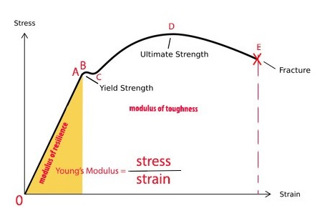
Stress-Strain Diagram:

Slide 8
Factor of Safety:
Factor of Safety (FoS) is a design principle used to ensure that structures or components can withstand unexpected loads or conditions beyond their intended use. It represents the ratio between the material's ultimate strength (or allowable stress) and the maximum expected operational stress.
Formula:
FoS $=\frac{\text{Ultimate} \text{Strength} \text{or} \text{Allowable} \text{Stress}}{\text{Maximum} \text{Expected} \text{Operational} }$
Purpose: To provide a margin of safety to account for uncertainties in material properties, load conditions, and potential defects.
Stress Concentration
Stress Concentration refers to the localized increase in stress around discontinuities or changes in geometry, such as holes, notches, or sharp corners in a material. These areas experience higher stress compared to the surrounding regions due to the disruption in the material's uniformity.
Factors Affecting Stress Concentration:
Geometry of the Discontinuity: Sharp corners or abrupt changes increase concentration.
Load Type and Direction: Affects how stress is distributed around the discontinuity.
Stress Concentration Factor (Kt): A dimensionless factor used to quantify the increase in stress due to the discontinuity.
σ_{max}=K_{t}⋅σ_{nominal}
Where:
σ_{max}​ is the maximum stress, and σ_{nominal}​ is the nominal (average) stress.

Slide 9
Fatigue
Fatigue is the progressive and localized structural damage that occurs when a material is subjected to cyclic loading. Over time, repeated loading and unloading can lead to the formation of cracks and eventual failure.
Characteristics:
Crack Initiation: Often starts from stress concentrators or defects.
Crack Propagation: The crack grows with each loading cycle.
Final Fracture: Leads to complete failure of the component.
Endurance Limit
Endurance Limit (or Fatigue Limit) is the maximum stress level a material can withstand for an infinite number of loading cycles without failing. It is a key parameter in designing components that experience cyclic loading.
For Ferrous Materials: Endurance limit is a well-defined value.
For Non-Ferrous Materials: The concept is less defined, and fatigue strength is often used.

Slide 10
Chapter 2: Design of Key
Definition of Key and function of key
Key is a machine element which is used to connect the transmission shaft to rotating machine elements like pulley, gear, sprocket or flywheel.
Keys provide a positive means of transmitting torque between shaft and hub of the mating element.
Definition of keyway
A slot is machined in the shaft or in the hub or both to accommodate the key is called keyway. Keyway reduces the strength of the shaft as it results in stress concentration.
Keys are made of ductile materials.
Types of Keys
Common types of keys are:
Sunk keys 2. Saddle keys
Sunk Keys
A sunk key is a key in which half of the thickness of key fits into the keyway in the shaft and half in the keyway of the hub.

Slide 11
The sunk keys are of the following types:
Rectangular sunk key:
It is the simplest type of key and has a rectangular cross-section. A taper of about 1 in 100 is provided on its top side. The usual proportions of this key are:
Width of key, w = d / 4;
and thickness of key, t = 2w / 3 = d / 6
where d = Diameter of the shaft or diameter of the hole in the hub. Square sunk key:
Rectangular sunk key having equal width and thickness is called square sunk key. i.e. w = t = d/4
Parallel sunk key:
If no taper is provided on the rectangular or square sunk key, it is called parallel sunk key i.e. it is uniform in width and thickness throughout. It is used where the pulley, gear or other mating piece is required to slide along the shaft.
Gib-head key:
It is a rectangular sunk key with a head at one end known as gib head, which is provided to facilitate the removal of key.

Slide 12
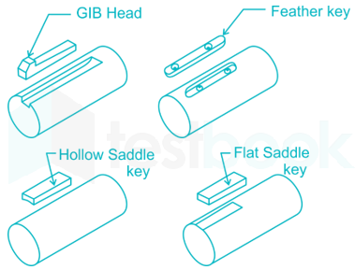
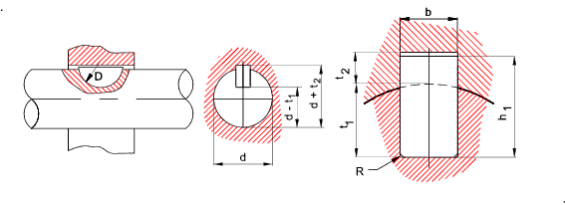
Feather key:
Feather key is a parallel key made as an integral part of the shaft with the help of machining or using set-screws. It permits axial movement and has a sliding fit in the key way of the moving piece. Feather keys are shown in Figure.
Woodruff key:
Woodruff key is a sunk key in the form of a semi-circular disc of uniform thickness. Lower portion of the key fits into the circular keyway of the shaft. It can be used with tapered shafts as it can tilt and align itself on the shaft. But the extra depth of keyway in the shaft increases stress concentration and reduces strength of the shaft. Woodruff key is shown in Figure.
Woodruff Key

Slide 13
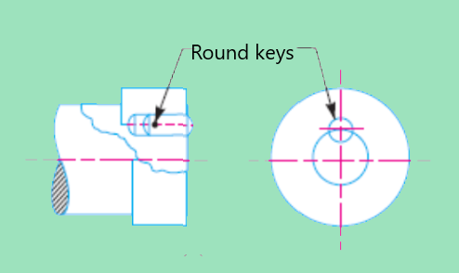
Round Keys:
The round keys have a circular cross-section and fit into holes drilled partly in the shaft and partly in the hub. Slot is drilled after the assembly so the shafts can be properly aligned. These are used for low torque transmission. Round keys are shown in Figure
Saddle Keys
Slot for this type of is provided only in the hub as shown in Figure. Torque is transmitted by friction only and cannot therefore transmit high torque and is used only for light applications.
The saddle keys are of two types:
Flat Saddle Key and Hollow Saddle Key.
In flat saddle key, the bottom surface touching the shaft is flat and it sits on the flat surface machined on the shaft.
Hollow saddle key has a concave surface at the bottom to match the circular surface of the shaft. Chances of slip in case of the flat saddle key are relatively lesser and can transmit more power than the hollow saddle key.

Slide 14
Thank You

