Slide 1
Government Polytechnic Chhapar
Mechanical Engineering Department
Hydraulics and Pneumatics E-Content
By: Rupesh Kumar
Lecturer in Mechanical Engineering
Govt. Polytechnic Chhapar

Slide 2
Chapter 1: Introduction
Introduction to Hydraulics and Pneumatics
Hydraulics and pneumatics are branches of fluid power engineering that use fluids to transmit and control energy. These systems are fundamental in various industrial applications, from machinery to aircraft.
Hydraulics involves the use of liquids, typically oil, to perform work. Hydraulic systems are known for their ability to generate high forces and precise control.
Pneumatics deals with the use of compressed air or other gases to transmit and control power. Pneumatic systems are often used for their simplicity and quick response, although they are generally less forceful compared to hydraulic systems.
Definition of Fluid
A fluid is a substance that continually deforms (flows) under an applied shear stress. Fluids can be categorized into:
Liquids: These have a definite volume but no definite shape. They adapt to the shape of their container but maintain their volume. Examples include water, oil, and alcohol.
Gases: These have neither a definite shape nor a definite volume. They expand to fill the shape and volume of their container. Examples include air, nitrogen, and helium.

Slide 3
Types of Fluid
Newtonian Fluids:
  These fluids have a constant viscosity, meaning their resistance to flow is consistent regardless of the applied stress.
  Examples include water and air.
Non-Newtonian Fluids:
  These fluids do not have a constant viscosity. Their resistance to flow changes with the applied stress or the rate of deformation.
  They can be further classified into:
    Shear-thickening Fluids: Viscosity increases with shear rate (e.g., cornstarch in water).
    Shear-thinning Fluids: Viscosity decreases with shear rate (e.g., ketchup).
    Thixotropic Fluids: Viscosity decreases over time with constant shear stress (e.g., some gels).
    Rheopectic Fluids: Viscosity increases over time with constant shear stress.

Slide 4
Properties of Fluids
Viscosity: A measure of a fluid's resistance to flow. It indicates how "thick" or "thin" a fluid is. Higher viscosity means greater resistance to flow.
Density: The mass of a fluid per unit volume. Density affects buoyancy and pressure. For gases, density varies with pressure and temperature.
Pressure: The force exerted per unit area. In a fluid, pressure is exerted equally in all directions.
Compressibility: The measure of how much a fluid's volume decreases under pressure. Gases are highly compressible, while liquids are relatively incompressible.
Temperature: Affects fluid properties such as viscosity and density. Higher temperatures usually decrease viscosity for liquids and increase viscosity for gases.
Surface Tension: The force that acts on the surface of a liquid, causing it to behave like a stretched elastic membrane. It is responsible for phenomena such as water droplets forming spherical shapes.
Flow Characteristics:
  Laminar Flow: Smooth and orderly flow where fluid particles move in parallel layers.
  Turbulent Flow: Irregular and chaotic flow with mixing of fluid particles.

Slide 5
Chapter 2: Pressure and its Measurements
Introduction to Pressure
Pressure is a fundamental concept in physics and engineering, defined as the force applied per unit area. It is a measure of how much force is exerted on a surface and can be experienced in various contexts, such as in fluids, gases, and solids. The formula for calculating pressure (P) is:
P=F/A
Where:
P = pressure
F = force applied
A = area over which the force is applied
Pressure is typically measured in units such as pascals (Pa), atmospheres (atm), or pounds per square inch (psi).

Slide 6
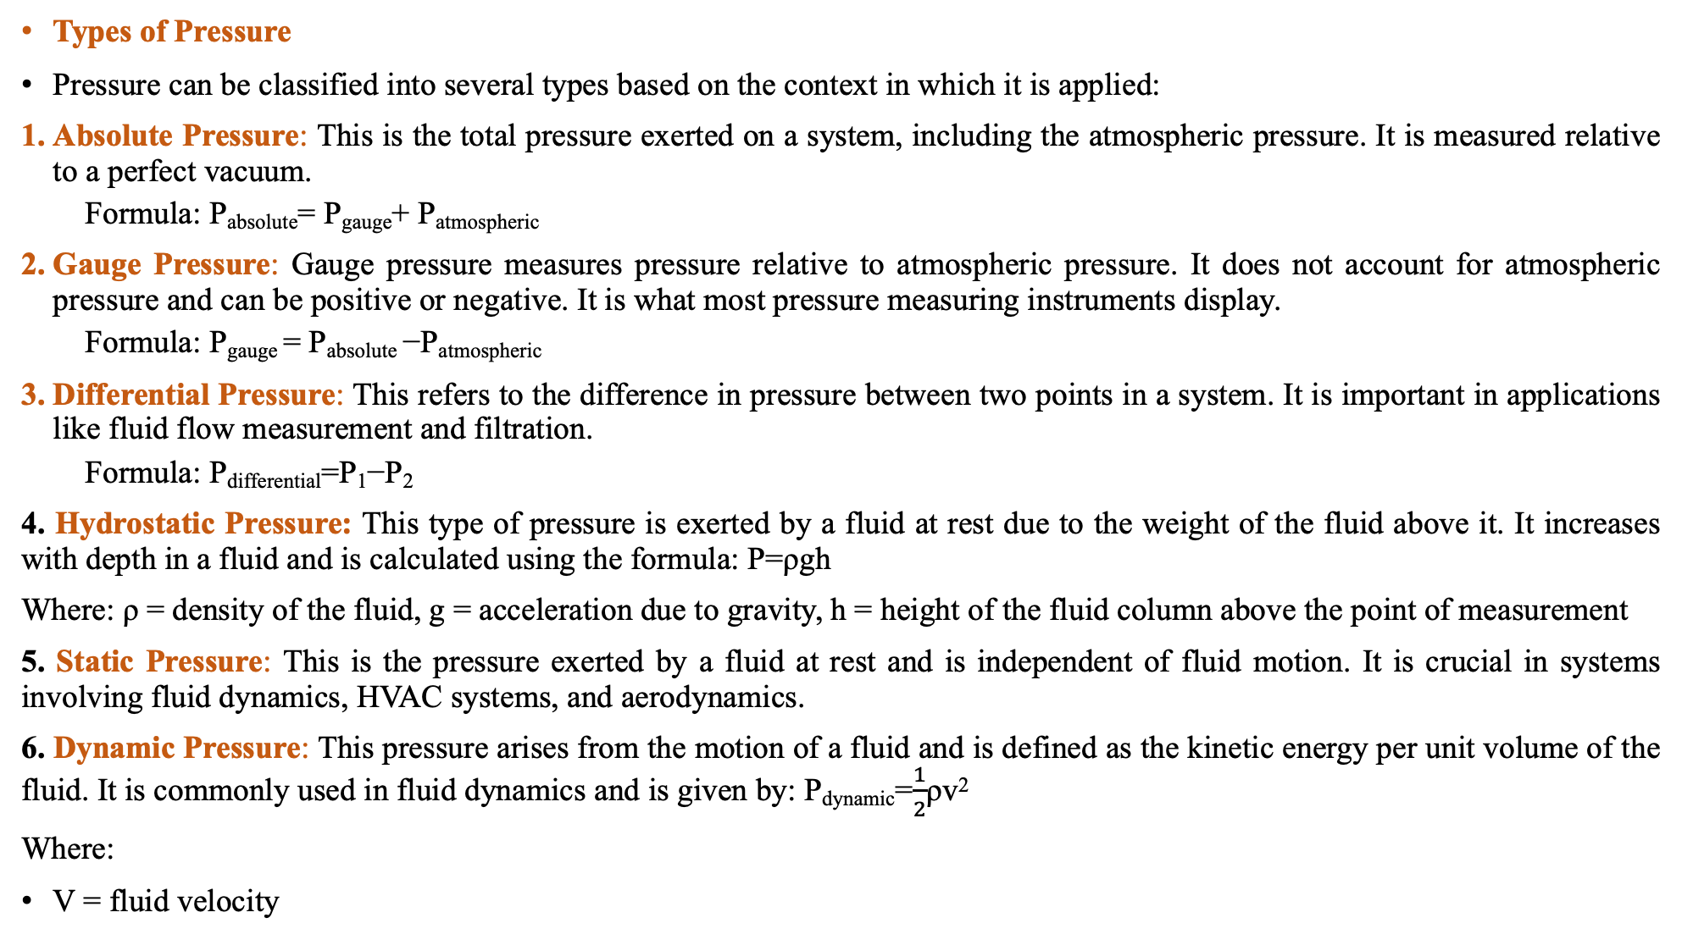
Types of Pressure
Pressure can be classified into several types based on the context in which it is applied:
Absolute Pressure: This is the total pressure exerted on a system, including the atmospheric pressure. It is measured relative to a perfect vacuum.
  Formula: P_{absolute}= P_{gauge}+ P_{atmospheric}​
Gauge Pressure: Gauge pressure measures pressure relative to atmospheric pressure. It does not account for atmospheric pressure and can be positive or negative. It is what most pressure measuring instruments display.
  Formula: P_{gauge} = P_{absolute} −P_{atmospheric}​
Differential Pressure: This refers to the difference in pressure between two points in a system. It is important in applications like fluid flow measurement and filtration.
  Formula: P_{differential}=P₁−P₂
4. Hydrostatic Pressure: This type of pressure is exerted by a fluid at rest due to the weight of the fluid above it. It increases with depth in a fluid and is calculated using the formula: P=ρgh
Where: ρ = density of the fluid, g = acceleration due to gravity, h = height of the fluid column above the point of measurement
5. Static Pressure: This is the pressure exerted by a fluid at rest and is independent of fluid motion. It is crucial in systems involving fluid dynamics, HVAC systems, and aerodynamics.
6. Dynamic Pressure: This pressure arises from the motion of a fluid and is defined as the kinetic energy per unit volume of the fluid. It is commonly used in fluid dynamics and is given by: P_{dynamic}=$\frac{1}{2}$ρv²
Where:
V = fluid velocity

Slide 7
1. Piezometer: A piezometer is a device used to measure the pressure of a fluid within a system. It is commonly employed in various fields such as hydraulics, geotechnics, and environmental engineering to measure pressure in fluids, typically groundwater, or to gauge the pressure head in a liquid column.
Working Principle: Hydrostatic Pressure Measurement: Piezometers typically measure hydrostatic pressure, which is the pressure exerted by a fluid due to its weight. The pressure measurement is often expressed in terms of the height of the fluid column in the piezometer.
Formula: P=ρgh, Where: P = Pressure, ρ= Density of the fluid, g = Acceleration due to gravity, h = Height of the fluid column
Applications
Groundwater Monitoring: Used to measure the pressure in wells and groundwater systems to monitor aquifer behavior and groundwater levels.
Soil Pressure Measurement: In geotechnical engineering, piezometers measure pore water pressure in soil to assess soil stability and behavior.
Hydraulic Systems: Employed in hydraulic systems to measure fluid pressures and ensure system performance.
Advantages: 1. Provides direct measurement of pressure. 2. Can be used in various fluids and soil conditions. 3. Simple and reliable for many applications.
Disadvantages: 1.Open-ended piezometers may not be suitable for high-pressure applications. 2. Installation and maintenance can be challenging in some environments. 3. Closed-ended types and advanced piezometers can be expensive.

Slide 8
2. U-Tube Manometer: A U-tube manometer is a simple device used to measure the pressure difference between two points in a fluid system. It consists of a glass tube bent into a U-shape filled with a liquid (usually mercury or water). The height difference between the two sides of the tube indicates the pressure difference.
Applications: Commonly used in laboratories and educational settings for measuring pressure differences in fluid systems.
Advantages: Simple construction, direct measurement, and low cost.
Disadvantages: Limited to low-pressure measurements; the liquid used must be compatible with the fluids being measured.
3. Micromanometer: A micromanometer is a high-precision instrument designed to measure very small pressure differences. It typically uses a liquid column or electronic sensors to measure these small variations accurately.
Applications: Used in scientific research, precision engineering, and applications requiring high accuracy in measuring small pressure differences.
Advantages: High accuracy and precision.
Disadvantages: Typically more expensive and complex compared to simpler manometers.
4. Differential U-Tube Manometer: This is a specific type of U-tube manometer designed to measure the pressure difference between two points in a system. It consists of a U-shaped tube filled with a liquid and has two openings connected to the points of interest. The liquid level difference in the two legs of the U-tube corresponds to the pressure difference.
Applications: Useful in applications where pressure difference measurements between two points are required, such as in HVAC systems, fluid flow measurements, and pressure drop assessments in pipelines.
Advantages: Provides a direct and visual measure of pressure difference. Simple construction.
Disadvantages: Like other U-tube manometers, it may not be suitable for measuring very high or very low pressures.

Slide 9
Thank You

